Slide 1
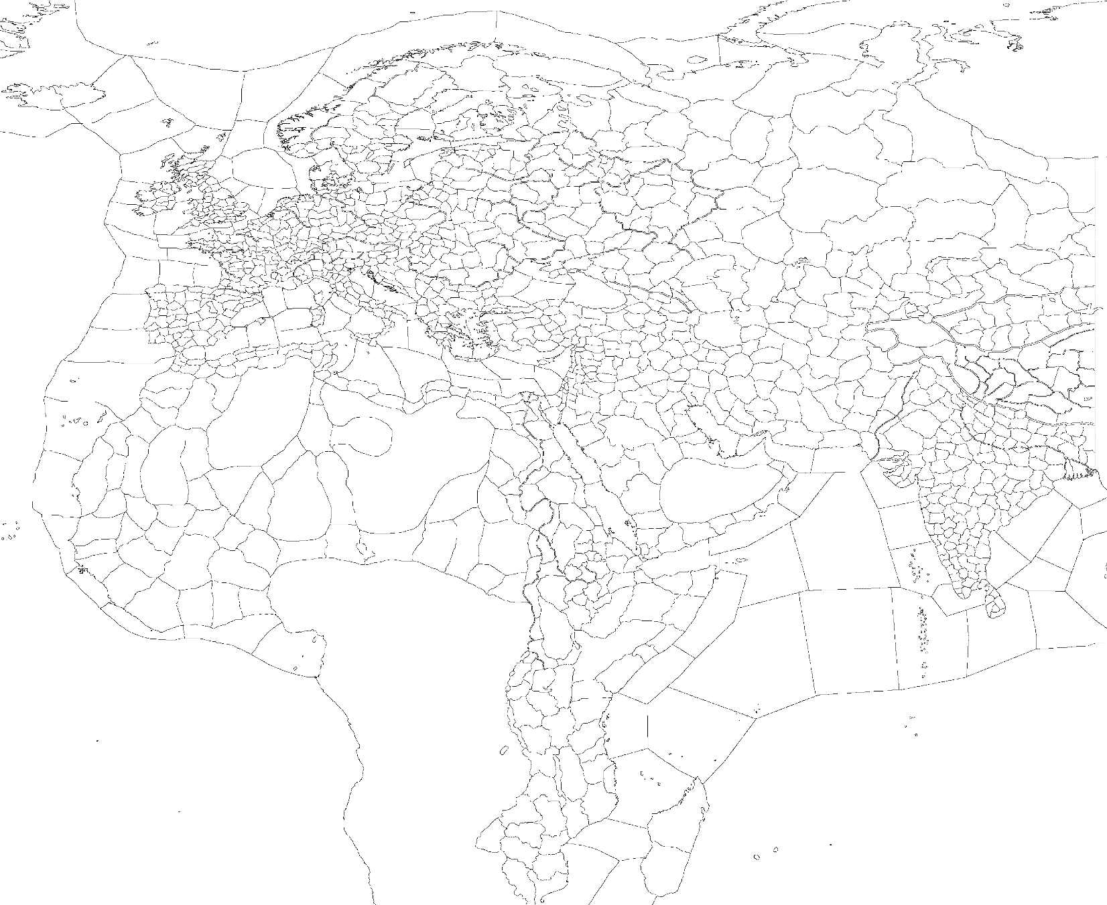
Western Christian
Religious Structure and Holy Sites
Shared Holy Sites
Mainstream Religion and its Heresies:
1
Catholic
Heresies: Donatist
Antinomian, Cathar, Fraticelli , Waldensian
Autonomous Religions:
2
Pelagian
2
Semipelagian
3
Unctionist
Reformed Religions:
Religion: unreformed religion
Religion: reformed religion
4
Consolamentian
(Cathar)
3
Franciscan
(Antinomian, Bogomilist, Fraticelli, Waldensian)
Cantium
Cantwarabyrig
2
Julich – Prum (Aachen)
3
Paris - St Denis
4
Konstantinoùpolis
Haghia Sophia
Narbo Martius - Albi
1
Rome
Carthago
Hierosolyma
Jerusalem

Slide 2
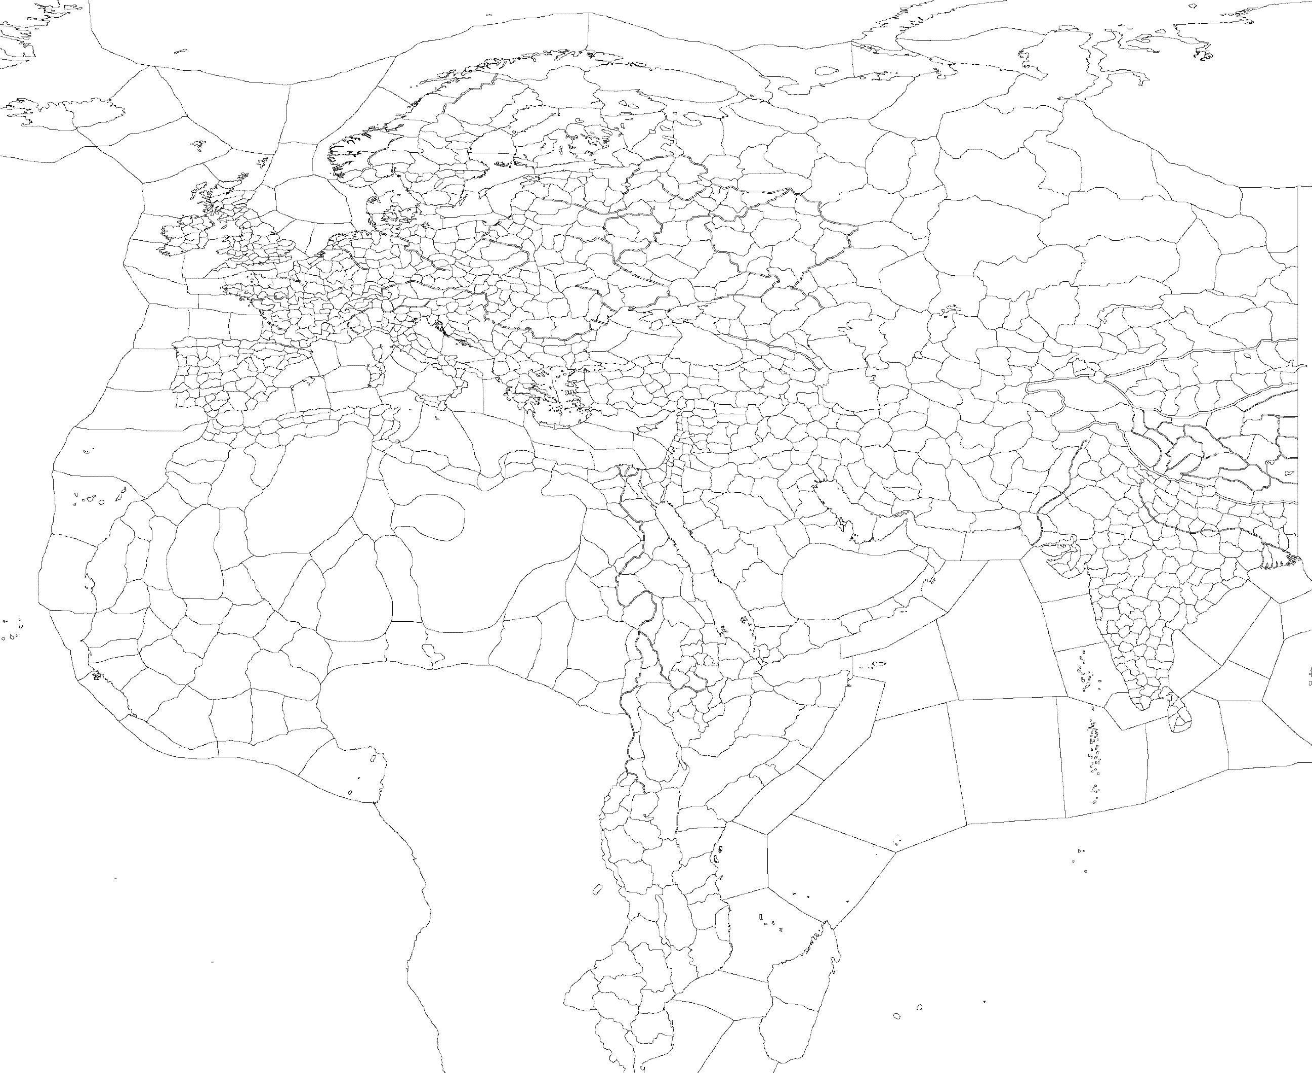
Eastern Christian
Religious Structure and Holy Sites
Shared Holy Sites
Mainstream Religions and their Heresies:
1
Monophysite
Heresies: Appolinarist, Eutychianist
2
Nestorian
Heresies: Docetist, Iconoclast
3
Orthodox
Heresies: Bogomilist, Melkite, Montanist, Sabellianist, Valentinian
Autonomous Religions:
Reformed Religion:
4
Audianist
5
Marcionist
6
Solomonic Christian
7
Phrygian
(Montanist)
Konstantinoùpolis
Haghia Sophia
Amisos Thermodon
Rome
3
7
5
1
Lychnidos Ohrid
Mycia
Militopolis
Dwin
Erchmiadzin
Antiochea r.d. of St Symeon
4
2
Nisibis
Alexandria
Hierosolyma
Jerusalem
Axum
r.d. of Aksum
6

Slide 3

Iberian Christian
Religious Structure and Holy Sites
Shared Holy Sites
Mainstream Religion and its Heresies:
1
Arian
Heresies: Adoptionist, Euskalist, Priscillian
Reformed Religions:
2
Marianist
(Euskalist)
3
Apologetic
(Priscillian)
Religion: unreformed religion
Religion: reformed religion
Nafarroa - Leyre
2
1
Vallisoletum
Segovia
3
Barcino - Vic
Rome
Qurtubah
Cabra
Carthago
Hierosolyma
Jerusalem

Slide 4
Arabo-Sabean
Religious Structure and Holy Sites
Shared Holy Sites
Mainstream Religions and their Heresies:
1
Almaqahi
Heresy: Ta'labi
2
Shamashi
Heresy: Al-Lati
Autonomous Religions:
Reformed Religion:
3
Attari
4
Hubali
3
Maherite
3
Waaqi
5
Abeed ash-Shamshi
(all unreformed except Maherite, that reforms to Almaqahi)
Religion: unreformed religion
Religion: reformed religion
Hierosolyma
Jerusalem
5
Baghdad
Hillah
Petra
4
‘Ar’ar
Dumat al Jundat
Makkah
Mecca
Mascat Samail
1
Zufar
Raysut
2
3
Azal
Gwandar
Roha

Slide 5
Persian
Religious Structure and Holy Sites
Shared Holy Sites
Mainstream Religions and their Heresies:
1
Zoroastrian
Heresies: Mazdakist, Zurvani
2
Manichaean
Heresies: Ahrimanic
Autonomous Religions:
Reformed Religions:
3
Angra Mainyui
4
Theomachian
1
Desnadi
(Mazdakist)
6
Datsani-Manichaean
(Tengri-Manichaean)
5
Zoroastrian Hindu
3
Angrayasnai
(Angra Mainyui)
7
Pitar Zrvânahe
(Zurvani)
Religion: unreformed religion
Religion: reformed religion
3
Akomanic
(Ahrimanic, Tengri-Ahrimanic – a Tengriist religion)
Om
Isilkul
6
Sharvan
Yanar Dag
Xvairizem
Airyanem Vaejah
4
3
2
Marakanda
Parsîâb
Kirmanshah
Peroz Kavadh
7
Ganzak
Âdur Gušnasp
Abarshahr
Âdur Burzen-Mehr
Pârsa
Estakhr
1
Laristan
Âdur Farnbâg
Tis
Darya-ye Hamun
5
Kachos
Mundra

Slide 6
Canaanite
Religious Structure and Holy Sites
Shared Holy Sites
Mainstream Religion and its Heresies:
1
Beelshameni
Heresy: Agliboli, Malakbelite
Autonomous Religions:
Reformed Religions:
2
Elohimi
1
Baalite
(all)
3
Hadadi
Religion: unreformed religion
Religion: reformed religion
4
Kothar-wa-Khasisi
Carthago
Palmyra
Al-Qa’im
Tyrus
Tyros
1
Hierosolyma
Jerusalem
Alexandria
2
Petra
4
Kambra
Kaniaga
Gwandar
Roha
3

Slide 7
Judaic
Religious Structure and Holy Sites
Shared Holy Sites
Mainstream Religion and its Heresies:
1
Yehudi
Heresies: Yahweh Sabaothite, Arôn Habrîtan
Autonomous Religions:
Reformed Religions:
Shekinahi
(Arôn Habrîtan)
2
Sethoitae
3
Khawdash Siyunic
1
Bnai Yiśraʾeli
(Jewish, Yahweh Sabaothite)
2
Tertifilian
(Sethian)
4
Religion: unreformed religion
Religion: reformed religion
1
Rome
Hierosolyma
Jerusalem
Alexandria
Gazzah Gaza
2
Bagdad
Hillah
Phoenikon
Mamlah
Soba Malaka
3
4
Axum
Aksum

Slide 8
Old Mesopotamian
Religious Structure and Holy Sites
Shared Holy Sites
Mainstream Religion and its Heresy:
1
Mandean
Heresy: Ruha d-Qudshai
Autonomous Religions:
1
Yahyanist
2
Yazdâni
2
Yazidi
Religion: unreformed religion
Religion: reformed religion
Reformed Religions:
3
Adunayic
(Ruha d-Qudshai)
1
Rišamman
(Mandean and Yahyanist)
2
Yârsâni
(Yazdâni and Yazidi)
Edessa Bile
Nisibis
Mazerun Rostamrood
2
3
Ganzak
Âdur Gušnasp
Hierosolyma
Jerusalem
1
Baghdad
Hillah
Shusha
Huzgan

Slide 9
Islamic
Religious Structure and Holy Sites
Shared Holy Sites
Mainstream Religions and their Heresies:
1
Ilm Islamic
Heresies: Ghazi Islamic, Hurufi, Mu’tazili
2
Shia
Heresies: Sufi, Kharijite, Qarmatian
3
Sunni
Heresies: Ash’ari, Athari, Maturidi, Murji’i, Zahiri
Autonomous Religions:
4
Druze
5
Haruri
6
Ibadi
7
Marabouti
Reformed Religions:
Mujahed
(Ghazi Islamic, Qarmatian)
4
Ahl al-Tawhidi
(Druze)
8
Ahl as-Safai
(Sufi, Marabouti)
9
6
Amir al-Mu'minini
(Ibadi, Kharijite)
Religion: unreformed religion
Religion: reformed religion
1
Qurtubah
Cabra
7
Fas
Zerhoun
9
Konstantinoùpolis
Haghia Sophia
8
Tawreš
Maragheh
Ash-Shams
Damascus
3
Druz
Awas
Bagdad
Hillah
Hierosolyma
Jerusalem
4
2
Al-’Anbar
Karbala
5
An Najaf
Kuffah
Al-Madinah
Masqat
Samail
6
Makkah

Slide 10
Graeco-Roman / Solar
Religious Structure and Holy Sites
Mainstream Religions and their Heresies:
1
Graeco-Roman
Heresies: Jupiterite
Religion: unreformed religion
Religion: reformed religion
2
Mithraic
Heresies: Mithraic-Christian
Shared Holy Sites
1
Neoplatonic
Heresies: Platonic Pythagorean
Autonomous Religions:
3
Solar-Imperial
Heresies: Solar-Christian, Solar-Manichaean
4
Alexandros-Amonite
5
Cybelite
6
Eosphorist
1
Platonic Christian
1
Platonic Islamic
1
Porphyryan
7
Imperial Cultist
8
Apollo-Heliosean
9
Apollo-Boreasean
10
Al-Shams Islamic
11
Ódinn-Sólar
12
Horsic
13
Ts'ähäy Mahremite
14
Dulefukan
Reformed Religions:
Olympist
(Graeco-Roman)
5
Matar Kubileyani
(Cybelite)
13
Maher Aelshadavi
(Maherite, Ts'ähäy Mahremite)
1
11
Sehuli
(Dažbogite, Saulic, Ódinn-Sólar, Horsic, Sowiloic, Jumalanpalvoja)
9
Septentrionist
(Apollo-Boreasean)
10
Ahl al-Shams
(Al-Shams Islamic)
14
Diwwokoan
(Dulefukan)
Holmgardr
Tikhvin
12
11
Palteskja
Braslaw
Panticapacum
Cherco
9
Konstantinoùpolis
Haghia Sophia
Roma
3
6
Tavium
Tavia
7
Trapezounda
Rizaion
Attiké
Piraeaus
1
5
Ephesos
Lebedos
2
Carthago
Ganzak
Âdur Gušnasp
Kyrene
Derna
8
Alexandria
Hierosolyma
Jerusalem
4
10
Petra
Siwa
Darfur
Fuka Lolong
Axum
Aksum
14
13

Slide 11
Germanic
Religious Structure and Holy Sites
Shared Holy Sites
Mainstream Religion and its Heresies:
1
Furistaz Siduzic
Heresy: Irminsulic
Autonomous Religions:
2
Wodanazic
3
Wulfilist
4
Teiwazic
Reformed Religions:
1
Niwjaz Siduzic
(Furistaz Siduzic, Irminsulic & Wodanazic0)
3
Woriibarstist
(Wulfilist)
4
Rextaz Situic
(Teiwazic)
Religion: unreformed religion
Religion: reformed religion
Brunswik
Paderborn
Stetin
Wollin
Nchalennia
Tholen
2
Wimares
Gera
Julich – Prűm (Aachen)
4
Bergheim
Lorsch
1
3
Munichen
Freising
Suebi
Konstanz

Slide 12
Norse
Religious Structure and Holy Sites
Shared Holy Sites
Mainstream Religion and its Heresies:
1
Forn Siðric
Heresies: Ófriðartrívaric, Ragnarökric
Autonomous Religions:
2
Njóla
3
Scandinist
4
Sunnutrú
Religion: unreformed religion
Religion: reformed religion
Reformed Religions:
3
Kristatrú
(Scandinist)
1
Ásatrú
(Ásatrú , Njóla and Ófriðartrívaric)
5
Røkkatru
(Ragnarökric)
Þróndheimr
Nidaros
4
5
Heiðmork
Hamar
Austfold
Bergheim
3
1
Östra Aros
2
Perym
Købmannahavn
Roskilde
Stettin
Wollin
Nchalennia
Tholen
Brunswik
Paderborn

Slide 13
Finnic
Religious Structure and Holy Sites
Shared Holy Sites (no distinct holy site)
Autonomous Religions: (no separate holy sites)
1
Suomenuskan
2
Ilmattarenpalvoja
3
Jumalanpalvoja
Reformed Religions:
1
Kalevalan
(Suomenuskan and Ilmattarenpalvoja)
Jumalanpalvoja reforms into Sehuli, a Solar religion.
Religion: unreformed religion
Religion: reformed religion
1
Karjala
Kalevala
Suomi
Rauma
Östra Aros
3
2
Kalevan
Haapasalo
Holmgarðr
Tikhvin
Perym
Saaremaa
Hiiumaa

Slide 14
Komi-Mordvin
Religious Structure and Holy Sites
Shared Holy Sites
Autonomous Religions:
1
Chumbylatic
2
Vattisen Yalist
3
Voipel'ean
Reformed Religions:
1
Küsotari
(Chumbylatic)
2
Sardashi
(Vattisen Yalist)
3
Voittoisa tuuli
(Voipel'ean)
Religion: unreformed religion
Religion: reformed religion
Holmgarðr
Tikhvin
Perym
Perm
Yomvosh
Belyy-Yar
Pereslav
Solotcha
1
2
Alatyr
Makaryevo
Bolghar
Chastye
Panticapacum
Cherco
3

Slide 15
Baltic
Religious Structure and Holy Sites
Shared Holy Sites
Mainstream Religion and its Heresy:
1
Dievasic
Heresy: Saulic
Autonomous Religions:
2
Peckolsic
2
Perkunan
Reformed Religion:
2
Romuvan
(all the above except Saulic)
Note: Saulic reforms into Sehuli, a Solar religion.
Religion: unreformed religion
Religion: reformed religion
Saaremaa
Hiiumaa
Klaipeda
Kretingale
Palteskja
Braslaw
Stettin
Wollin
2
1
Chelmno
Briesen
Gardinas
Novogrudok

Slide 16
Slavic
Religious Structure and Holy Sites
Shared Holy Sites
Mainstream Religion and its Heresy:
1
Perunic
Heresy: Velesic
Autonomous Religions:
2
Dabogite
3
Dragomirist
1
Rodic
4
Slavic Christian
5
Rodnoveric
1
Svarogan
1
Svetovidan
Reformed Religions:
1
Slavianist
(all above except Slavic Christian and Dragomirist)
4
Slavonic Theantropist
(Slavic Christian)
3
Woriijadtist
(Dragomirist)
6
Rodist
(Rod Tengrili, a Tengriist religion)
Religion: unreformed religion
Religion: reformed religion
Holmgarðr
Tikhvin
5
Palteskja
Braslaw
Pereslav
Solotcha
Ciervisti
Magdeburg
2
Krakow
Jedrzejow
1
Kiev
Yuriev
6
Mikrotanais
Sviatohirsk
3
Nitra
Moravce
Galich
Lviv
4
Panticapacum
Cherco

Slide 17
Tengriist
Religious Structure and Holy Sites
Shared Holy Sites
Autonomous Religions:
1
Ahriman Tanrili
2
Buda Tanrili
3
Erlik Tanrili
4
Gökh Tanrili
5
Kong Tanrili
6
Mani Tanrili
7
Rod Tanrili
Reformed Religion:
6
Bai-Ülgeni
(Mani Tanrili)
4
Ulu Gökh Tanrili
(Gökh Tanrili)
3
Ulu Ordogh Tanrili
(Erlik Tanrili)
5
Yitian Chóngbài
(Kong Tanrili)
Reforms into another religious family:
Ahriman Tanrili reforms into Akomanic, a Persian religion
Buda Tanrili reforms into Datsanist, a Buddhist religion
Rod Tanrili reforms into Rodist, a Slavic religion
Religion: unreformed religion
Religion: reformed religion
Pereslav
Solotcha
4
7
Bashqortostan
Belebey
Om
Isilkul
Sharkil
Ak Tcheshme
Aral
Aral Arjan Suu
Altay
Kutuk Tindu Suu
1
3
Alatau
Khan Tangiri Chokusu
Xvairizem
Airyanem Vaejah
6
5
Marakanda
Parsiâb
Kashgar
2
Kathmandu
Kusinara

Slide 18
Celtic
Religious Structure and Holy Sites
Shared Holy Sites
Mainstream Religion and its Heresy:
1
Druidic
Heresy: Lughite
Autonomous Religions:
2
Endovelican
3
Hibernicist
Religion: unreformed religion
Religion: reformed religion
Reformed Religions:
1
Thuata Dé
(Druidic and Lughite)
2
Iberist
(Endovelican)
3
Christo-Cúchulainnist
(Hibernicist)
Tuadh-Mhumhain
Cell Dalua
Gwynedd
Bangor
Cantium
Cantwarabyrig
Aquae Sulis
Ynys yr Afalon
3
Darioritum
Karnag
1
Auréliens
Fleury
2
Ulyssippo
Alcobaça

Slide 19
Indo-Hellenic
Religious Structure and Holy Sites
Shared Holy Sites
Autonomous Religions:
1
Indo-Hellenic
2
Eusobeian
3
Sindhian Hindu
4
Pyromantic
Reformed Religion:
1
Indolatreían
(Indo-Hellenic)
Religion: unreformed religion
Religion: reformed religion
Marakanda
Parsiab
2
1
Kuhandiz
Drapsaka
Bagdad
Hillah (« Seleukia »)
Baktria
Oxiana
Taxila
Taksasila (“Sirkap”)
Bam
Vahmakada
4
Alexandria Sindhia
Pasni
3
Alexandria Euttara
Noida

Slide 20
Zalmoxian
Religious Structure and Holy Sites
Shared Holy Sites
Mainstream Religion and its Heresies:
1
Zalmoxian
Heresies: Christo-Zalmoxian, Apogenesianist
No autonomous religion
Religion: unreformed religion
Religion: reformed religion
Vadum Exercitus Henffordd
Galich
Lviv
Nitra
Moravce
Maurokastron Noviodounos
("Saka-katai" for Sarmatians)
Sarmizegethusa Kôgajon

Slide 21
Luwian
Religious Structure and Holy Sites
Shared Holy Sites (no distinct holy site)
Mainstream Religion and its Heresy:
Luwian
Heresy: Illuyankan
Autonomous Religions:
Tarhuntite
Reformed Religions:
Religion: unreformed religion
Religion: reformed religion
Typhonist
(Illuyankan)
Tarhuntist
(Tarhuntite)
Konstantinoùpolis
Haghia Sophia
Tavium - Tavia ("Chattousa")
Ikonion
Lisdra
Nisibis
Hierosolyma
Jerusalem

Slide 22

Berber
Religious Structure and Holy Sites
Shared Holy Sites
Autonomous Religions:
1
Amanaii
2
Amazigh
3
Gurzili
Reformed Religion:
2
Mastimani
(all Berber religions)
Religion: unreformed religion
Religion: reformed religion
Fas
Zerhoun
Sirta
Tebessa
2
Carthago
3
1
Leptis Magna
Nalut
Agadir
Ouaouteit
Garama
Osrhoene
Tombuto
Sankore

Slide 23
West African
Religious Structure and Holy Sites
Shared Holy Sites
Autonomous Religions:
1
Anansi
1
Nyame
2
Serer
3
Yorùbá
Reformed Religion:
3
Fat Roogan
(Anansi, Nyame and Serer)
Religion: unreformed religion
Religion: reformed religion
Fas
Zerhoun
Sanghana
Touba
2
Tombuto
Sankore
3
Zinder
Owshank
Kambra
Kaniaga
Eweduko
Ife
1
Aboisso
Boldumsaz

Slide 24
Ancient Egyptian
Religious Structure and Holy Sites
Shared Holy Sites
Mainstream Religion and its Heresies:
1
Amunite
Heresy: Atenist, Ra-Horakhtic
Autonomous Religions:
Reformed Religions:
2
Isetite
1
Kemetic (Amunite, Ra-Horakhtic)
3
Sutahi
1
Amarnist (Atenist)
2
Sekhmetist (Isetite)
3
Kheprian (Sutahi)
Religion: unreformed religion
Religion: reformed religion
Alexandria
Siwa
(“Timasirayn”)
1
Memphis
Bilbays (“Hut-ka-Ptah”)
Syene
Elefantina (“Karnak”)
Dongola
Delgo
2
Darfur
Fuka Lolong
Medewi
3

Slide 25
East African
Religious Structure and Holy Sites
Shared Holy Sites
Autonomous Religions:
1
Amatongo
2
Batembuzi
3
Imanai
2
Kintu
4
Kurembori
5
Msolo
6
Mwari
7
Nyakalagan
8
Nyau
Reformed Religion:
4
Mbambui
(Kurembori)
7
Ruoth Nyasayi
(Nyakalagan)
1
Unkulunkulan
(Amatongo)
3
Munguist
(Others)
Religion: unreformed religion
Religion: reformed religion
Gondokoro
Ashli
4
Serapium
Balcad
Bunyoro
Buliisa
2
Buganda
Buhuli
Mwanza
Sengerema
Ujiji
Kigoma
3
7
Zanzibar
Koani
Karonga
Mzuzu
8
5
Niassa
Metangula
Chidzurgwe
Ruanga
6
Zimbabwe
Khami
1
Kangwane
Malelane

Slide 26
Tibetan
Religious Structure and Holy Sites
Holy Sites
Autonomous Religion :
Bön
Reformed Religion:
Dzogcheni
Religion: unreformed religion
Religion: reformed religion
Gaindam
Samye
Rudok
Nu
Gyirong
Lhara (nearby Mount Kailash)
Lhasa
Jokhang
Kathmandu
Kusinara

Slide 27
Indian
Religious Structure and Holy Sites
Mainstream Religion and its Heresy:
1
Hindu
Heresy: Vidharmic
Autonomous Religions:
2
Jaina
3
Kartikeyan
4
Kuberan
5
Nasrani
4
Saura
Reformed Religions:
3
Arumugani
(Kartikeyan)
4
Reformed Kuberan
(Kuberan)
6
Malankara
(Nasrani)
4
Surya Brahmani
(Saura)
Religion: unreformed religion
Religion: reformed religion
5
Nisibis
Haridwara
Benarios
Sarnath
Dvaraka
Khimrana
1
2
Varodaros
Shatrunjaya
Celingeos
Jagannath Puri
3
Dravida
Pottapi
Kerala
Alappuzha
6
Madura
Samayanallur
4
Trikuta
Devanagara

Slide 28
Buddhist
Religious Structure and Holy Sites
Mainstream Religion and its Heresies:
1
Sthaviravada
Heresies: Bahusrutiya, Mahayana, Buddhaksetran
Autonomous Religions:
2
Buddha-Mazdan
3
Chán
1
Pratyekan
4
Vajrayana
Reformed Religions:
5
Mahadipika
(Buddha-Mazdan)
3
Linji
(Chán)
6
Datsanist
(Buda Tanrili, a Tengriist religion)
Religion: unreformed religion
Religion: reformed religion
Panchekanth
Ohrusana
4
6
Alatau
Khan Tangiri Chokusu
Krorän
Mogao
3
5
Abarshahr
Âdur Burzen-Mehr
Alexandria cistes Indós
Goth Ghanni
1
Gomateia
Lumbini
2
Kathmandu
Kusinara
Matsia
Pushkar
Benarios
Sarnath
Gaya
Bodh Gaya

Slide 29
Confucian
Religious Structure and Holy Sites
Shared Holy Sites
Autonomous Religions:
1
Confucian
2
Konphosian
3
Daojiao
4
Fengxian
Reformed Religions:
3
Linji
(Daojiao)
4
Lushèngdìjun Chóngbài
(Fengxian)
Kitai
Religion: unreformed religion
Religion: reformed religion
1
Ni Shān
2
Alexandria Tsangana
Kashgar
Krorän
Mogao
Gaindam
Samye
3
Rudok
Nu
Gyirong
Lhara (nearby Mount Kailash)
4
Lhasa
Jokhang

